Slide 1


PSM and RDD
Muhammad Akmal Farouqi
27/3/2024
www.ugm.ac.id
Locally Rooted, Globally Respected

Slide 2
PROPENSITY SCORE MATCHING

Slide 3
Matching Process
It helps to create a counterfactual sample (control group) when random assignment is unavailable, unfeasible, or unethical. by using an index instead of specific covariates to match, PSM mitigates the curse of dimensionality associated with “exact match” techniques.
PSM process will result PSA which is the score (probability) of being in a treatment group, conditional on observed baseline covariates.
Several Matching methods:
Nearest Neighbor Matching (NNM)
GenOptimal Matching (OM)
etic Matching (GM)
And the PS will be estimated using:
Logistic Regression
Random Forest
Artificial Neural Network (ANN)
The framework of propensity score matching
Data Preparation
PS Estimation
Data Matching
Balance Diagnostic
Estimation

Slide 4
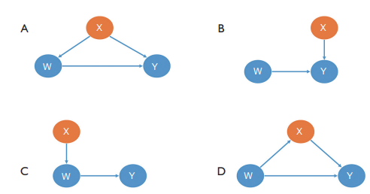
Deciding Covariates
Not all covariates need to be balanced. We can analyze the different relationships between the covariate (X), the treatment assignment (W), and the outcome (Y)
V
V
X
X

Slide 5
Estimating PS
Logistic Regression is the most used estimation method because its simplicity and interpretability. It works just like an ordinary regression which able to control several variables so chosen observations would not be biased!
Matching Method
Several Matching methods:
Nearest Neighbor Matching (NNM) (Known as greedy matching) = Running through the treated units and selecting the closest eligible control unit
Optimal Matching (OM) = it is optimal in the sense that it attempts to choose matches that collectively optimize an overall criterion
Optimal Full Matching = assigns every treated and control unit in the sample to one subclass with each of the subclass contains 1 treated unit and 1 or more control units (the method optimizes sum of the absolute within-subclass distances in the matched sample!
Different matching algorithm could result different chosen control group and Propensity score! Therefore, we need some balance diagnostic test to see which method yields most balanced comparison group!

Slide 6
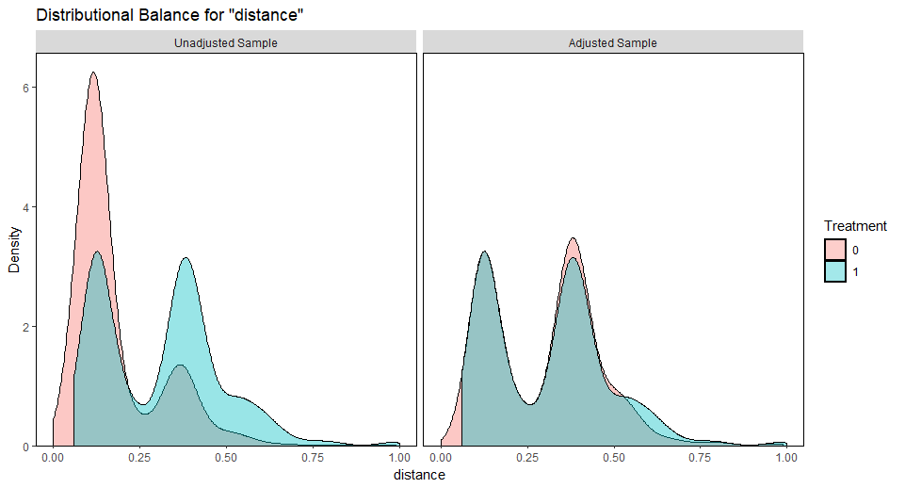
Balance Diagnostic Test
There are some statistic indicators we can use to determine whether the selected control group are relatively balance (the tests will be similar like goodness of fit)
Standardized Mean Diff: The SMDs are computed as the mean difference divided by a standardization factor computed in the unmatched sample. An absolute SMD close to 0 indicates good balance
Variance Ratio: variance ratio for the treated group and control group for each covariate. A variance ratio close to 1 indicates good balance
eCDF: The eCDF statistics correspond to the difference in the overall distributions of the covariates between the treatment groups. The values of both statistics range from 0 to 1, with values closer to zero indicating better balance
We also can compare the adjusted sample of methods you choose
https://kosukeimai.github.io/MatchIt/articles/assessing-balance.html

Slide 7
Estimation
After performing PS analysis, we’ll get the Pscore. This Pscore acted like “weighting variables” that will adjust your observations so each groups have the same characteristics even though sample observation is unbalanced
So, there will be two options:
Drop unmatched data
Use full data with weighting on it.
Currently, there are many advanced research paper that also suggests further analysis using ATE and ATT!
The Average Treatment Effect (ATE) is the average of the individual treatment effects of the population under consideration. And the Average Treatment Effect of the Treated (ATT) is simply the average of the individual treatment effects of those treated

Slide 8
REGRESSION DISCONTINUITY

Slide 9
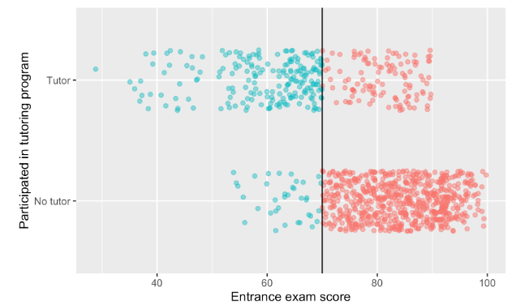
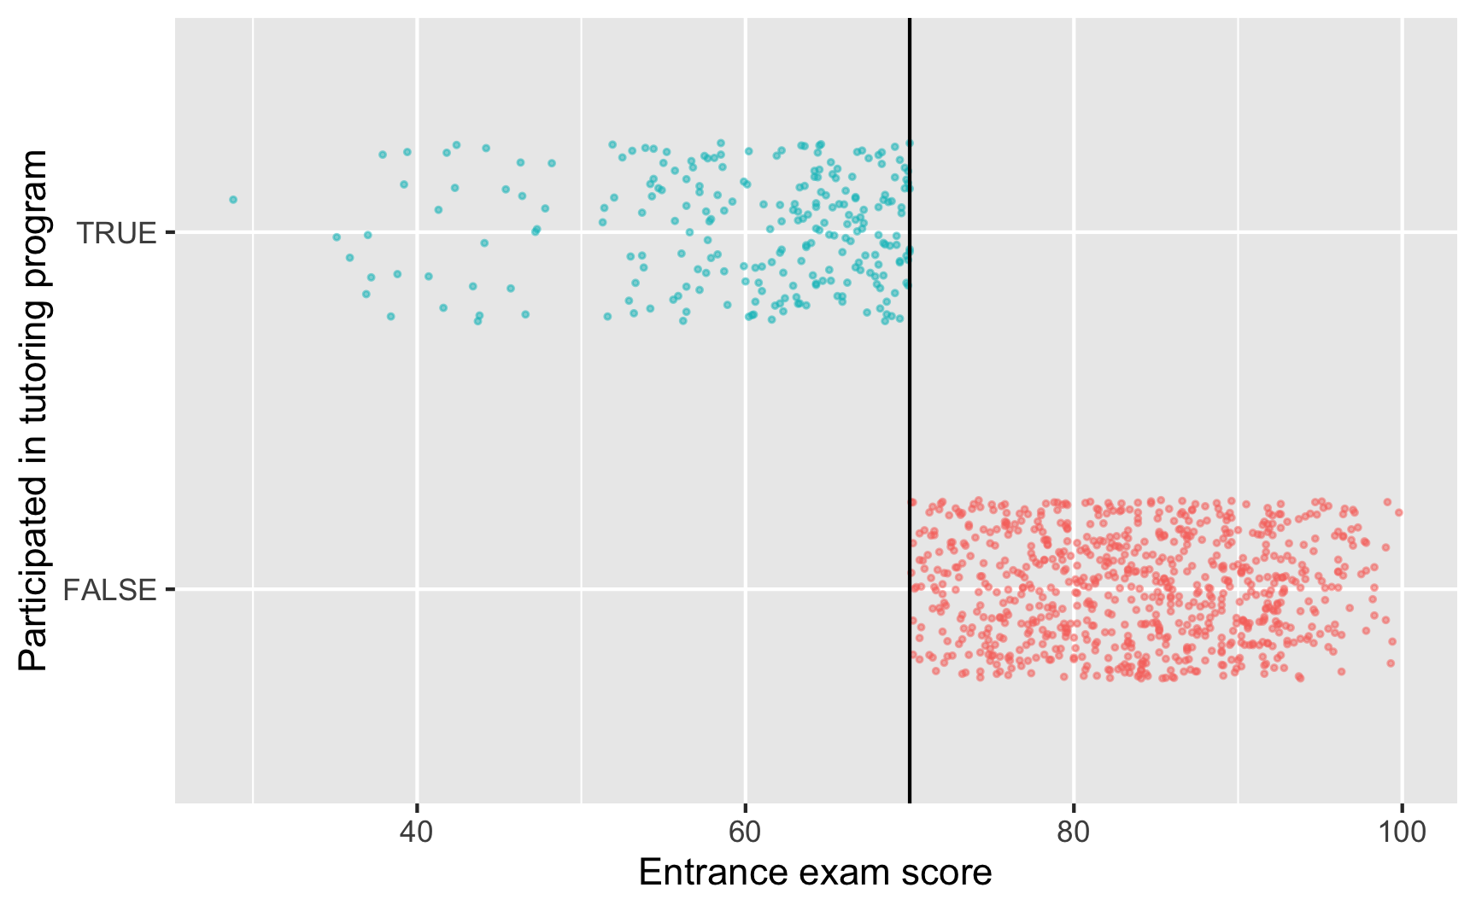
CONCEPT
Regression discontinuity (RD) research designs exploit precise knowledge of the rules determining treatment. RD identification is based on the idea that in a highly rule-based world, some rules are arbitrary and therefore provide good experiments. RD comes in two styles, fuzzy and sharp. The sharp design can be seen as a selection-on-observables story. The fuzzy design leads to an instrumental-variables-type setup.
Sharp RD
Fuzzy RD

Slide 10

CONCEPT
Regression discontinuity (RD) research designs exploit precise knowledge of the rules determining treatment. RD identification is based on the idea that in a highly rule-based world, some rules are arbitrary and therefore provide good experiments. RD comes in two styles, fuzzy and sharp. The sharp design can be seen as a selection-on-observables story. The fuzzy design leads to an instrumental-variables-type setup.
Sharp RD
Fuzzy RD

Slide 11
Thank You

